Slide 1

.NET Applications at Scale on Amazon Web Services
Norm Johanson
Software Developer,
Amazon Web Services
Level: Intermediate

Slide 2
Overview
Overview of the AWS Services
Getting Started with the Windows Tools
AWS SDK for .NET
AWS Tools for Windows PowerShell
AWS Toolkit for Visual Studio
Running Applications on AWS
Handling Scale
Code on GitHub at : https://github.com/awslabs/aws-sdk-net-samples

Slide 3
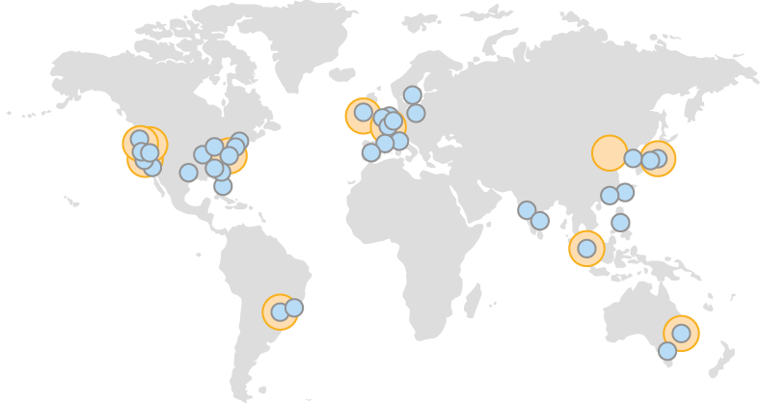
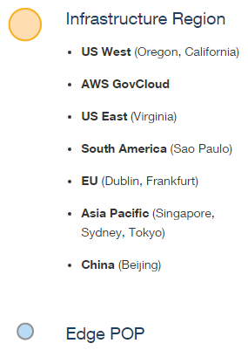
Regions and Availability Zones

Slide 4
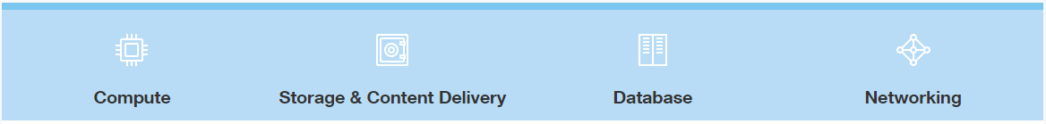
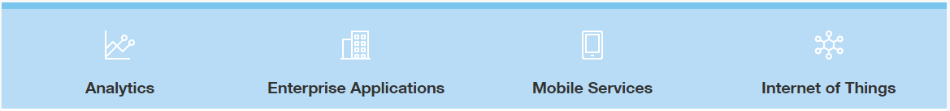
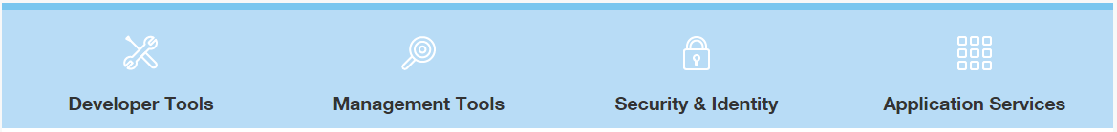
50+ Cloud Services
Infrastructure Services
Platform Services
Developer Productivity and Operational Efficiency Services

Slide 5
Compute & Networking
Amazon Elastic Compute Cloud (EC2)
Elastic Load Balancing
Auto Scaling
Virtual Private Cloud (VPC)

Slide 6







An example VPC setup
No access to/from wider internet – all non-local traffic is routed to private
gateway and onto corporate network
10.0.0.1
10.0.0.2
10.0.0.3
Subnet 1: 10.0.0.0/24
Availability Zone A
corporate data center
Router
Virtual Private
Gateway
VPN Connection
Customer
Gateway
10.0.1.1
10.0.1.2
10.0.1.3
Subnet 2: 10.0.1.0/24
Availability Zone B
10.0.0.0/16

Slide 7
Storage & Databases Services
Amazon Simple Storage Service (S3)
Object Storage
Amazon DynamoDB
Managed NoSQL
Amazon Relational Database Service (RDS)
Oracle
MySQL
PostgreSQL
Amazon Aurora
SQL Server

Slide 8
Deployment Services
AWS CloudFormation
Define AWS resources with a JSON document
AWS Elastic Beanstalk
Sets up all the resources to run an application
Deploys .NET Web Applications
AWS CodeDeploy
Scriptable deployments

Slide 9
Tools for .NET Developers
AWS SDK for .NET
AWS Tools for Windows PowerShell
AWS Toolkit for Visual Studio
https://aws.amazon.com/sdkfornet
SDK available through NuGet

Slide 10
AWS SDK for .NET
Version 3
Release last July
Each service separate NuGet packages
AWSSDK.S3
AWSSDK.EC2
ASP.NET 5 Support
Support in the 3.2 beta versions of the SDK
dnxcore-development Git branch
Open Source
https://github.com/aws/aws-sdk-net

Slide 11
Credentials
Requests need to be signed with Credentials
AWS Access Key ID
Secret Access Key
Identity and Access Management Service (IAM)
Root Credentials (Full Access)
IAM Credentials (Restricted Access)

Slide 12
Demo Using S3
Object storage
Images
Videos
Objects are stored in a bucket
Buckets have globally unique names
Objects identified by a user-defined key
Keys are often filenames

Slide 13
AWS Tools for Windows PowerShell
Setting Up
Credentials
Region
CmdLet Naming
PowerShell Verbs
Service Acronym
Finding CmdLets
Get-AWSCmdletName

Slide 14
Running Applications on AWS
Do it yourself
Directly use EC2
Manage it for me
AWS Elastic Beanstalk
AWS creates the compute architecture
Hybrid
AWS CodeDeploy
Developer creates the compute architecture

Slide 15
AWS Elastic Beanstalk Deployment
Automatically creates necessary AWS resources
Retain full control over AWS resources
Deploys WebDeploy archives
Integrates with Visual Studio

Slide 16
AWS Elastic Beanstalk primitives
Application
Logical container for the application
Application version
Pointer to the application bundle in S3
Environment
The AWS resources that run the application

Slide 17
ZipCode Deployment Summary
Elastic Beanstalk
Handles Deployment, Provisioning, Load Balancing & Auto Scaling
IAM Roles
Controls Access
Delivers AWS Credentials
EC2 Key Pair
Decrypts Windows Password
Application Bundle
WebDeploy Archive

Slide 18
AWS CodeDeploy
Scripted Deployment
PowerShell
Batch Files
Building Block Service
You design your compute architecture

Slide 19
AWS CodeDeploy primitives
Application
Logical container for the application
Deployment group
EC2 instances
Deployment
Application bundle
appspec.yml

Slide 20


Compute Architecture
CodeDeploy deployment group
Micro A
Micro A
Micro A
Micro B
Micro B
Micro B
Micro C
Micro C
Micro C
Micro D
Micro D
Micro D
Micro E
Micro E
Micro E
Load balancer
EC2 instances

Slide 21
Compute Architecture (Alternative)
Higher traffic services
Micro A
Micro A
Micro A
Micro B
Micro B
Micro B
Micro C
Micro C
Micro C
EC2 instances
Lower traffic services
Micro D
Micro D
Micro E
Micro E
EC2 instances

Slide 22
Pollster Architecture
Web front end (ASP.NET 5 MVC WebApp)
Poll Feed (MVC Web API)
Scheduling Engine
(Console Application)
Vote Processor
(MVC Web API)
Poll Creator
(MVC Web API)
http://www.cloud-pollster.com/

Slide 23
Pollster Deployment Summary
AWS CloudFormation
Create Compute Architecture
Custom Deployments
Defined in appspec.yml
Execute PowerShell scripts
ASP.NET 5
Use dnu for package
Bundle runtime with application
Create custom deployment commands

Slide 24
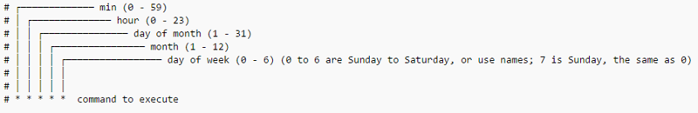
Scheduled Scaling
Auto Scaling Scheduled Actions
One time start and stop
Recurring schedule actions
End of the week timesheets
Cron Scheduling in GMT time
0 20 * * 5 (Start at noon Pacific Time)
0 2 * * 6

Slide 25
CloudFront
Content Delivery Network (CDN)
Cache Static Content
Images
Javascript
Cache Dynamic Content
Control TTL
Web Access Control List
Protect your web applications from common web exploits

Slide 26
What Next?
Simple Queue Service & Simple Notification Service
Distributed Computing
CloudWatch
Monitoring & Alarms
Docker
ASP.NET 5 & Elastic Beanstalk

Slide 27
SDK GitHub
https://github.com/aws/aws-sdk-net
Samples and Talks
https://github.com/awslabs/aws-sdk-net-samples
AWS PowerShell
http://aws.amazon.com/powershell/
AWS Toolkit for Visual Studio
http://aws.amazon.com/visualstudio/
AWS .NET Blog
http://blogs.aws.amazon.com/net
Twitter
@awsfornet

Slide 28
AWS Tools for Windows & .NET Developers
Thank You

